Slide 1
Contents
Introduction
Objective
Scope Of System
Proposed Systems And Advantages
Module Description
Snapshot of home page
Snapshot of login Page
Snapshot of Signup Page
Snapshot of backend code coverage
Technology Used

Slide 2
Introduction
My aim is to develop a single page application. This application aims to enhance the ease of the buyer as well of seller of furniture. This project use database to store the information about the user,furniture,cart,oderdetails and the address. This application help the seller to post their furniture description as well as the photograph of their furniture which they want to sell. For the client side I have used the angular 8 and for the server side I have use the spring boot framework.

Slide 3
Objective
To save the time.
To save the energy of seller as well as of buyer.
To have a user friendly and attractive interface.
Ease in operating the application.
The authenticity of the user as well as of the furniture.

Slide 4
SCOPE OF THE SYSYTEM
Specifically designed for buying and selling purpose.
Inserting new furniture for selling is possible.
Ordering as much as you want is possible.
Modes of payment is possible.
Filtering is possible. Buyer can filter the furniture according to their interest.

Slide 5
Proposed system and advantages
Seller can post any time and from anywhere about their product
Buyer can have much more options according to their need.
It will save the time as well as the energy of the users.
Buyer can choose modes of payment according to their convenience.

Slide 6
Module Description
User signup
User Login
Post furniture as seller
Add to cart furniture as a buyer
Proceed to buy now
Add Address
Choose mode of payment
Order details.

Slide 7
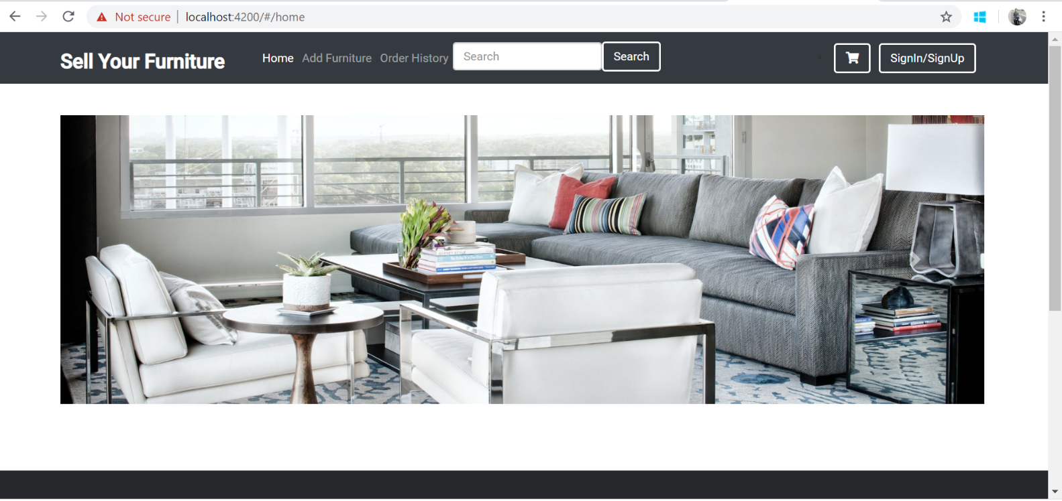
home page

Slide 8
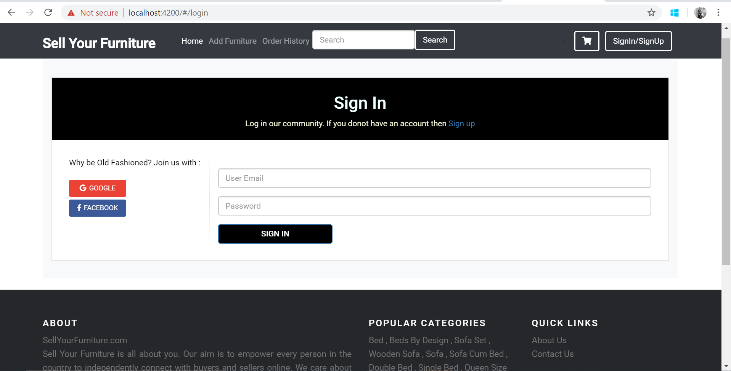
Login page

Slide 9
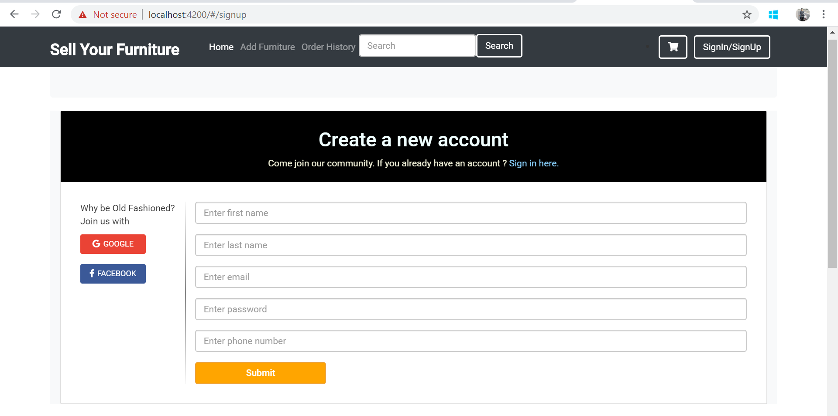
Signup page

Slide 10
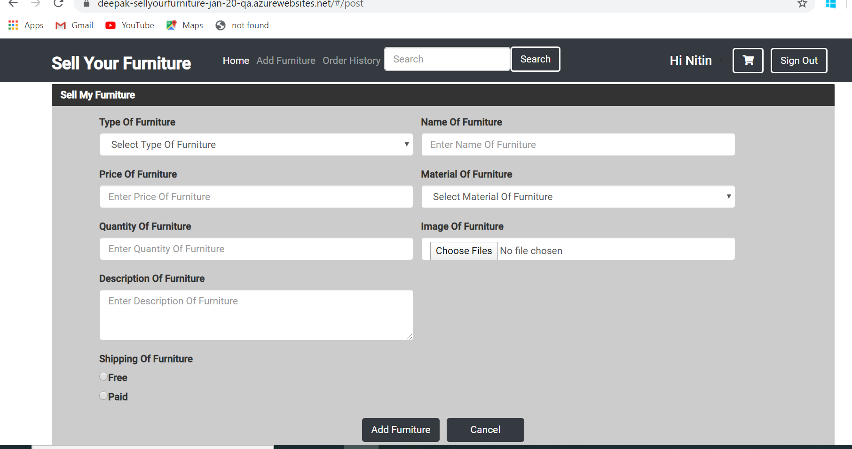
ADD FURNITURE

Slide 11
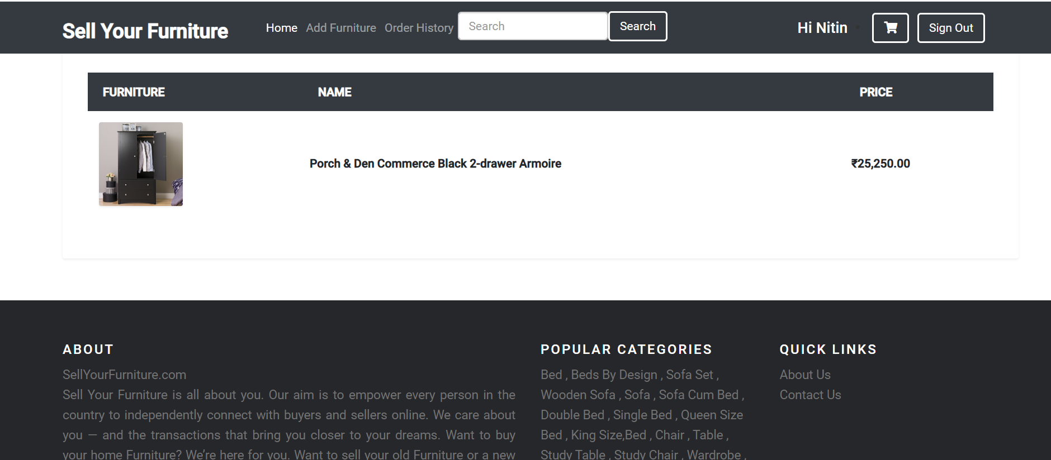
ORDER-HISTORY

Slide 12
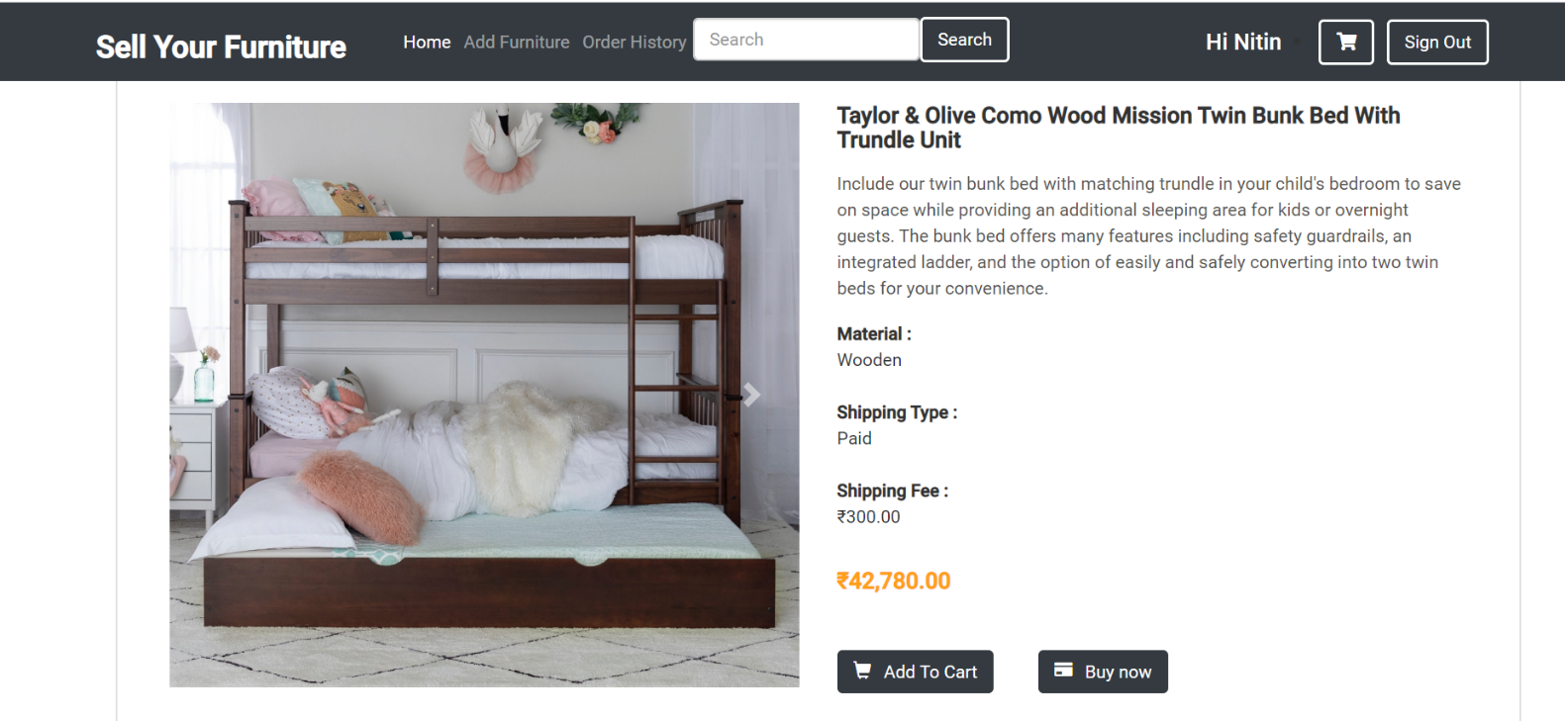
VIEW-PRODUCT

Slide 13
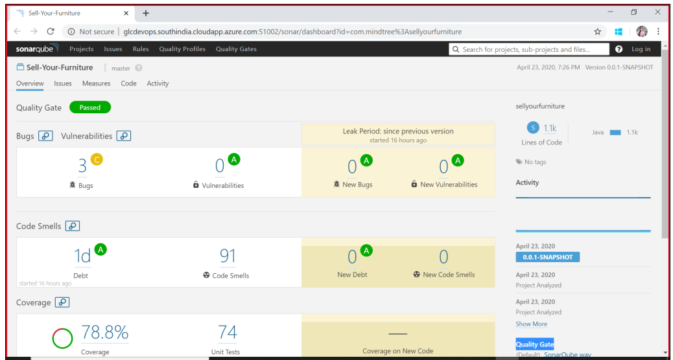
Backend code coverage

Slide 14
Technology used
Front End:-
Spring boot framework.
Junit testing.
Swagger.
Sonar
Back End:-
Angular 8
Html
CSS
Bootstrap
Jasmine and karma
Typescript

Slide 15
THANKYOU!!
b

